Slide 1

H2O Contact Manager
Group: Cleveland Endians
Members: Cole Albers, David Sinchok, Sam Yinger, Andrew Fox, Adam Prater

Slide 2








What is H2O Contact Manager?
Online database manager SPECIFICALLY created for H2O Church: Connect Card Team
Allows H2O Church: Connect Card Team members to:
Login to a secure database manager
Search for contacts within the database
Create contacts within the database
Edit contacts within the database
Delete contacts within the database
Filter the data within the database
View all prayers submitted by contacts
View all comments submitted by contacts

Slide 3
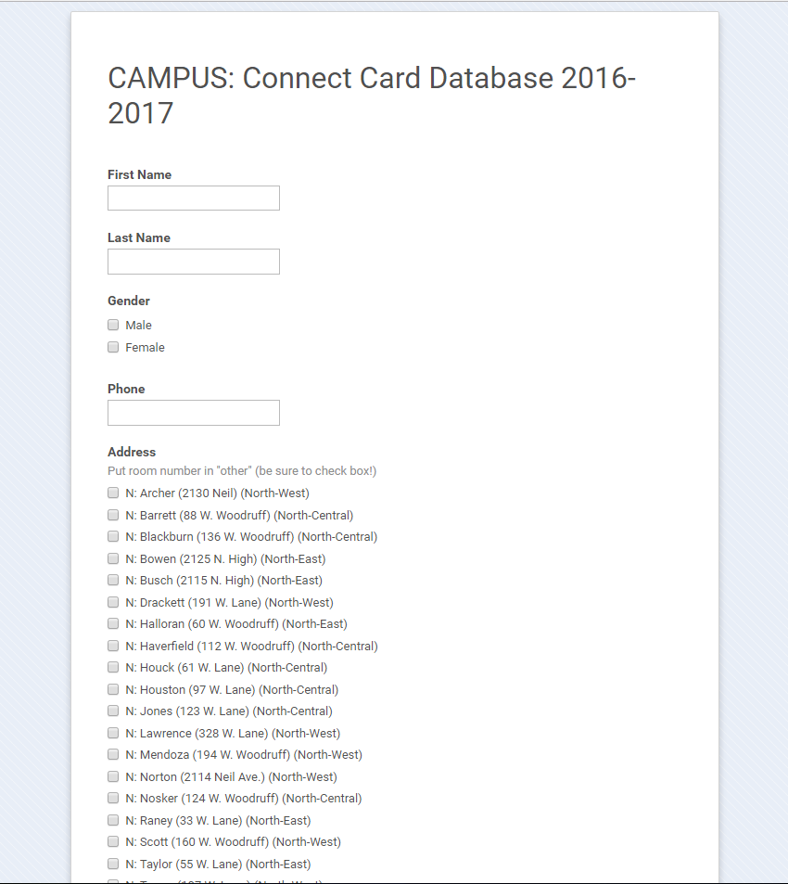
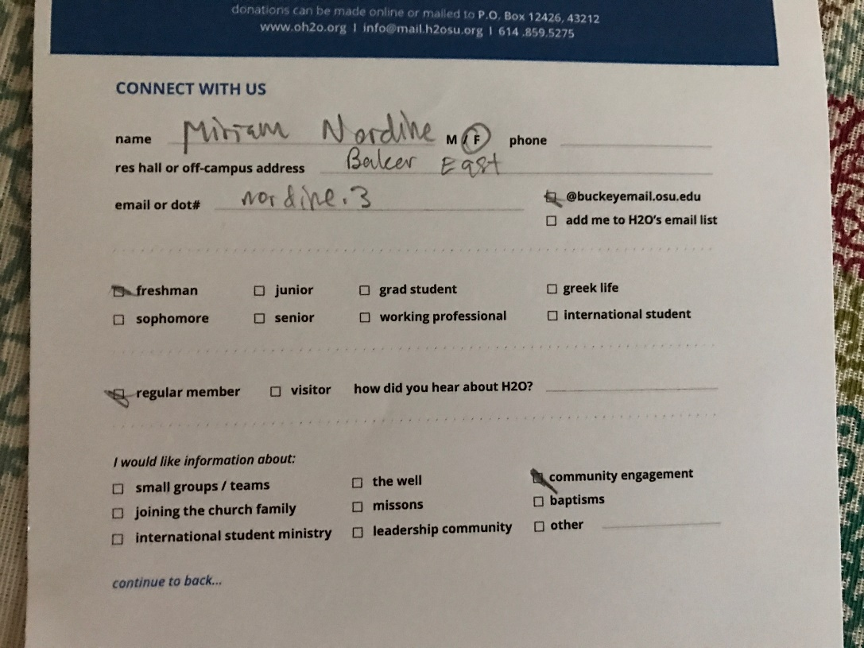
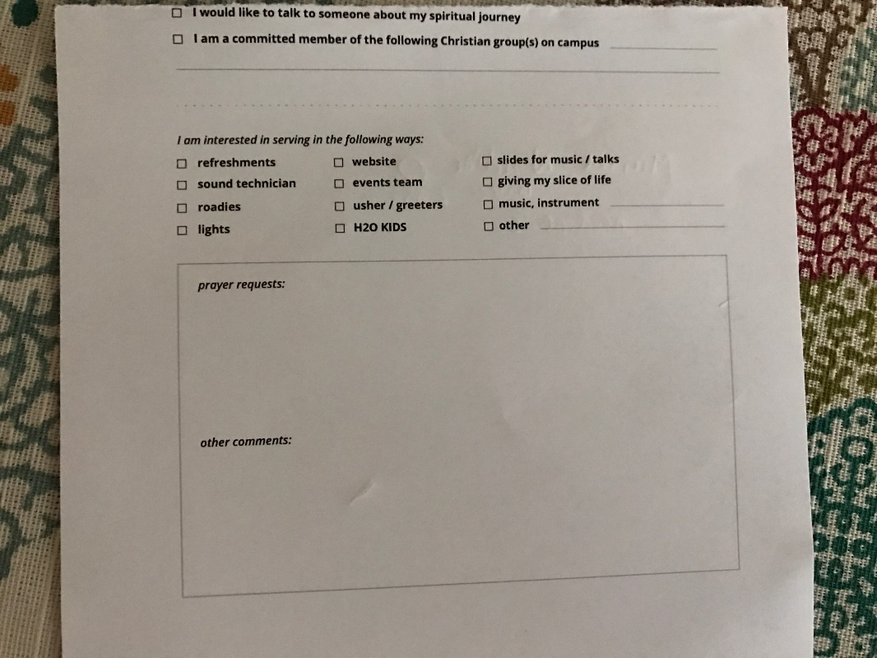


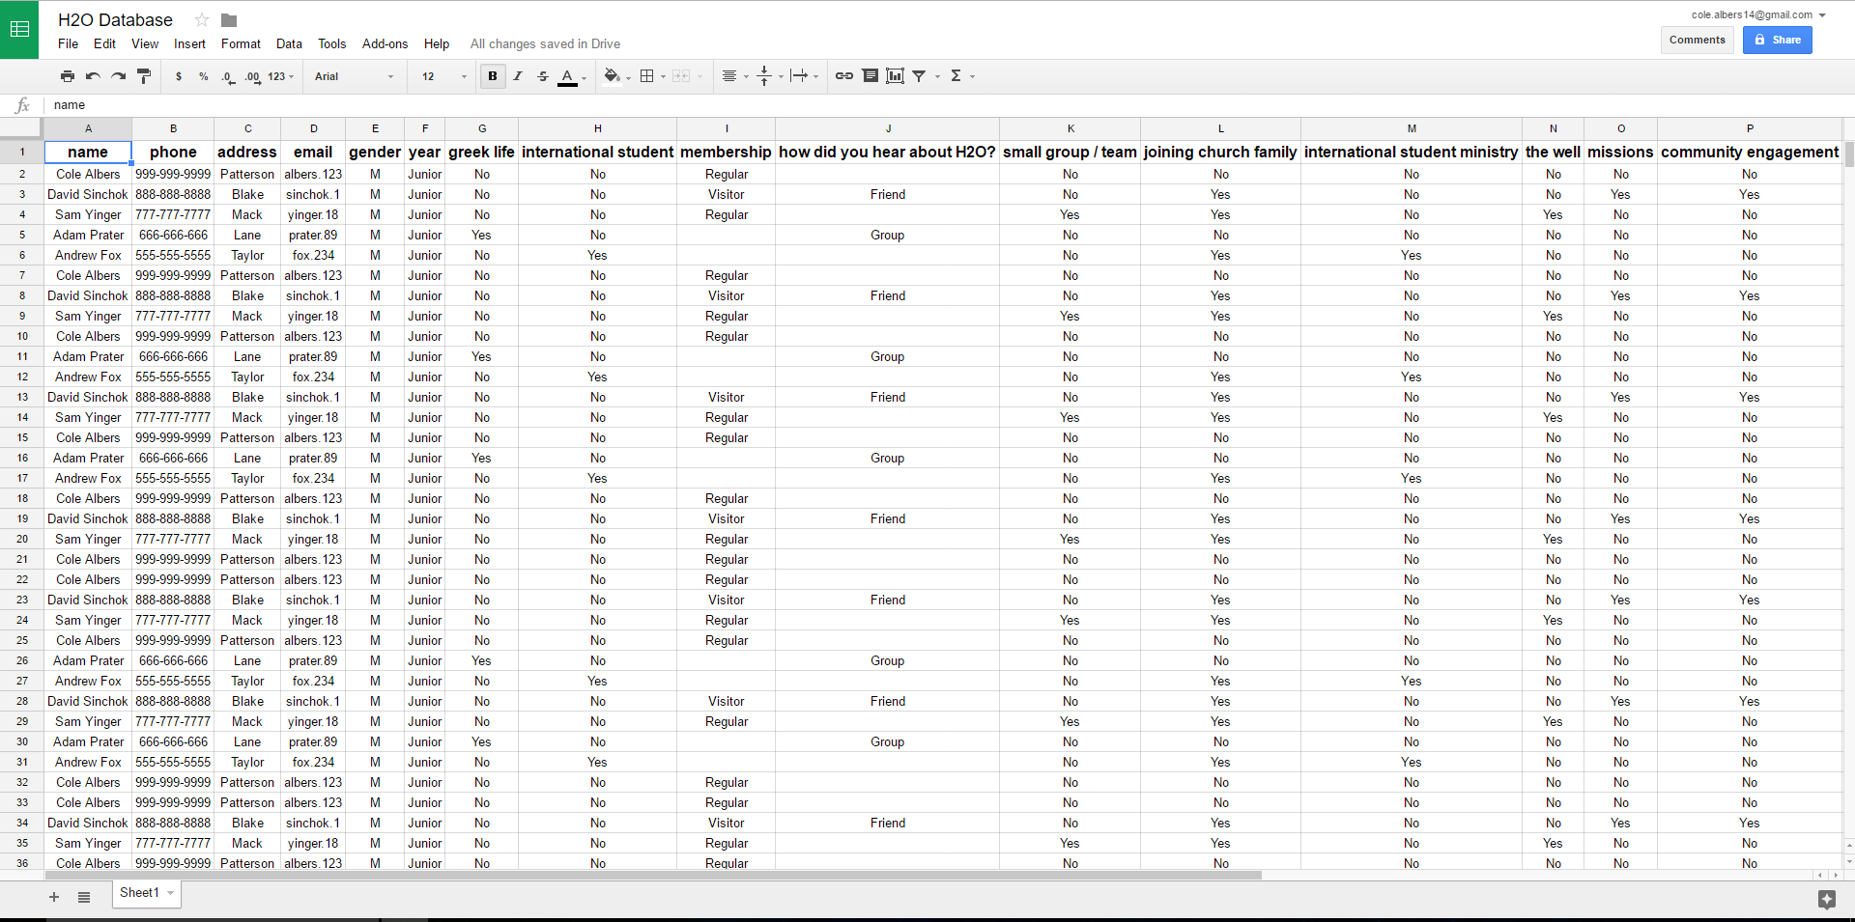
What does H2O Contact Manager solve?
Task of H2O Church: Connect Card Team
take hand written forms
transfer the forms information onto an online form (Google Forms)
Submit the form information to the “database” (Google Sheets)
VERY INEFFICIENT. VERY TIME CONSUMING. VERY ANNOYING.
the current “database” accepts duplicate contacts
hard to navigate database and filter specific data
have to retype forms even when information is already in database
Our H2O Contact Manager is the SOLUTION!

Slide 4
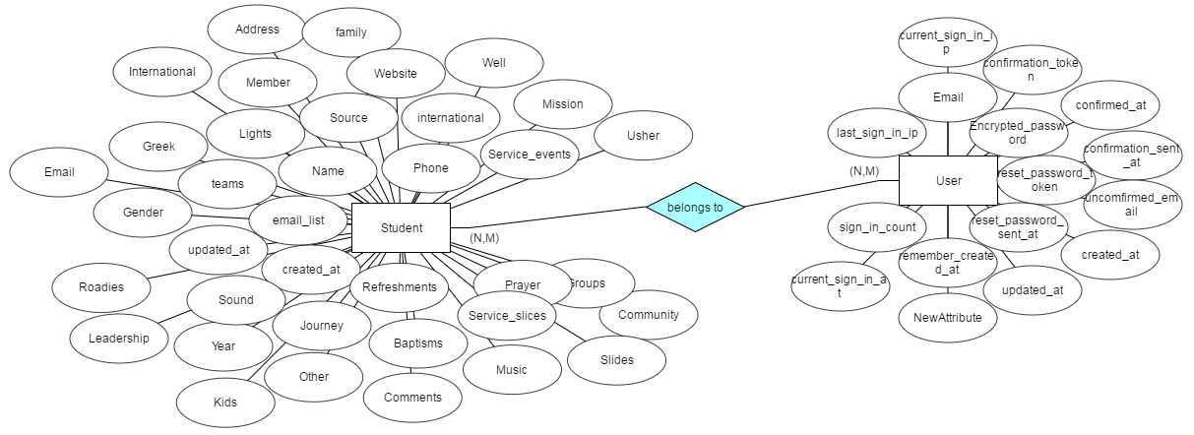
ER Diagram

Slide 5
State Diagram : Non-user
Landing
Login
Sign Up
Forgot Password
Resend

Slide 6
State Diagram : Non-user
Landing
Login
Sign Up
Forgot Password
Resend

Slide 7
State Diagram : User
root home
Login
get search
Root Page
get comments
get filter / get data
get prayers
Search
Comments
Data
Prayer
create
edit
edit
delete comment
edit
Create
Delete
Edit
delete prayer

Slide 8
State Diagram : User
Login
Root Page
Search
Comments
Data
Prayer
Create
Delete
Edit

Slide 9

Implementation of Routes: Page Navigation
Root route
Get routes
Search
Find
Filter
Data
Prayers
Comments
Signed out
Delete routes

Slide 10
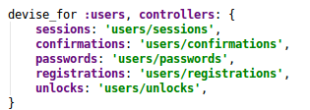
Implementation of Routes: Devise Routes
Devise routes
Sessions
Confirmations
Passwords
Registrations
Unlocks

Slide 11
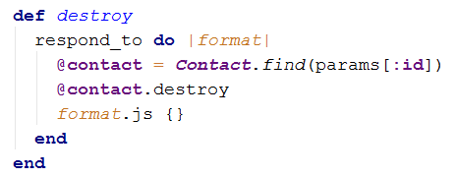
Controller Implementation
Resourceful route functions
Additional Functionality
Find
Filter
Additional Technologies
Devise
Ajax
Kaminari

Slide 12
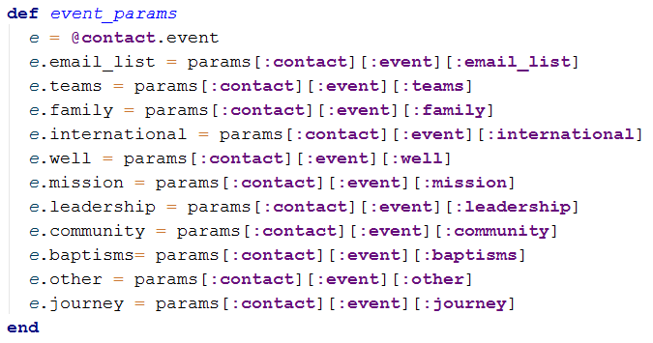
Controller Implementation Helpers
Parameter Handling
Large amount of data
Nested forms and parameters

Slide 13




Other Frameworks/Technologies
Devise – Signup/Authentication/Log-in
Kaminari – Pagination
Bootstrap – Styling
Ajax – Asynchronous page updates
jQuery - JavaScript

Slide 14
DEMO

